Slide 1
Primary 2/3 Mrs Hamill
Curriculum Information
2020 / 2021

Slide 2
Teaching in a Composite Class
Teaching that takes place in a composite class very similar to single year group classes
Each year group will be taught the components of their own specific curriculum
Lesson format can vary depending on objectives being taught. Lessons may take the form of:
whole class teaching with activities differentiated for each year group (and ability).
separate year group teaching for specific curriculum objectives, with the other class completing consolidation or extension activities
carousel activities where groups rotate between tables and activities, some of which are teacher led and some of which are independent.
Each child, regardless of year group, will complete activities that are designed to consolidate, practise and extend learning
Daily communication and weekly meetings with other year group teachers help ensure that learning for each year group is consistent
There are many added benefits to composite class teaching – forming new friendship groups, learning from each other, sharing knowledge with the younger year group.
One of the biggest benefits is that when teaching each year group, the ratio of teacher to pupil is much smaller. This makes it easy to gage understanding and ask challenging questions during teacher time.

Slide 3
Timetable
Lessons begin at 9am
Literacy and numeracy are taught 5 times per week
Activity-based learning (ABL) / play based learning (PBL) sessions take place 3 times per week
Teaching of World Around Us and ICT take place on a cross curricular basis and through ABL / PBL
PE sessions are once per week
We strive to engage in outdoor learning at least once per week on top of outdoor activities in ABL/PBL
RE sessions are taught one/twice per week

Slide 4
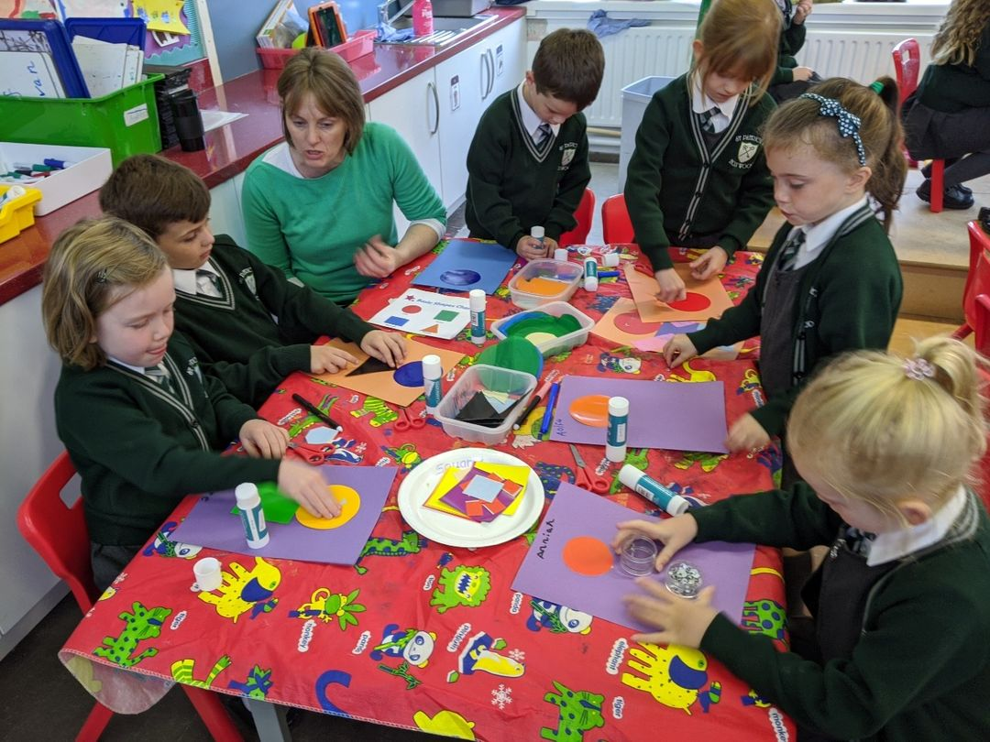
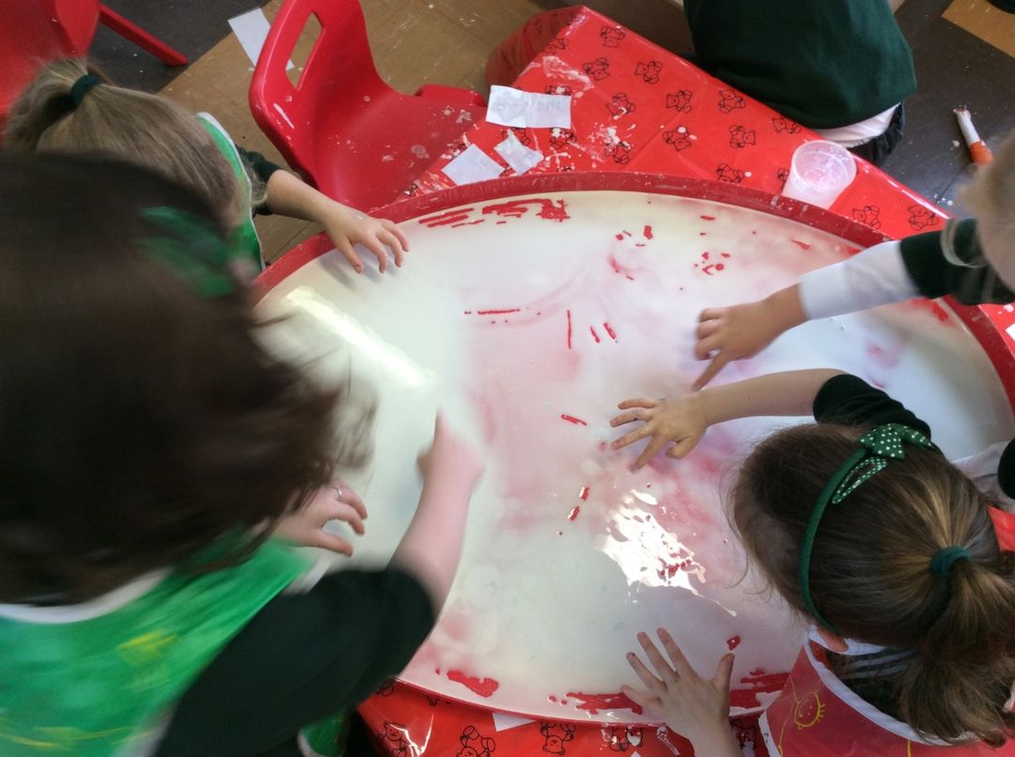
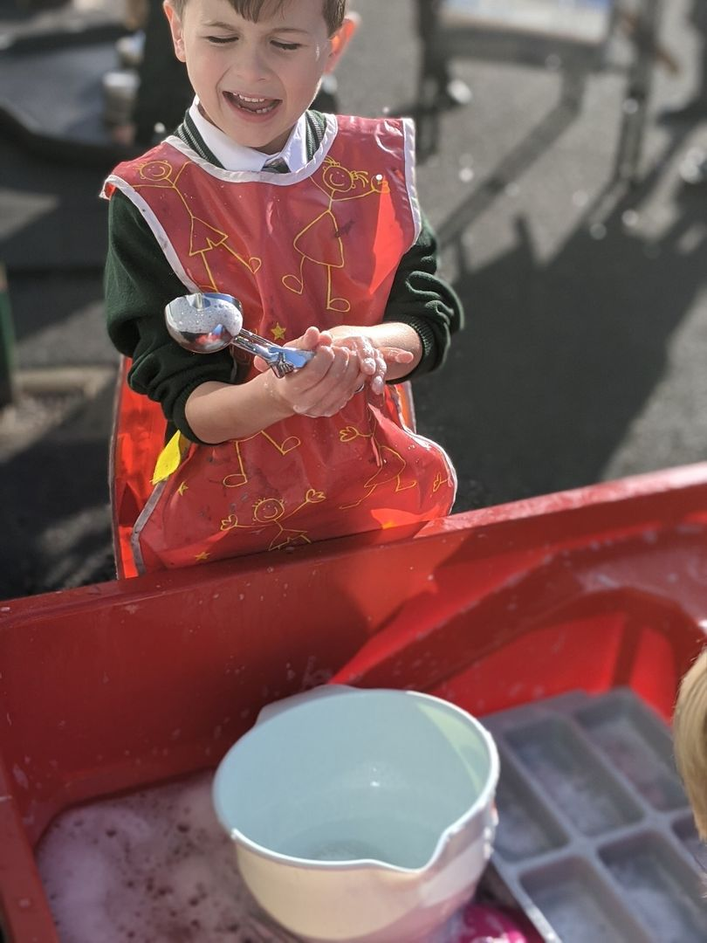
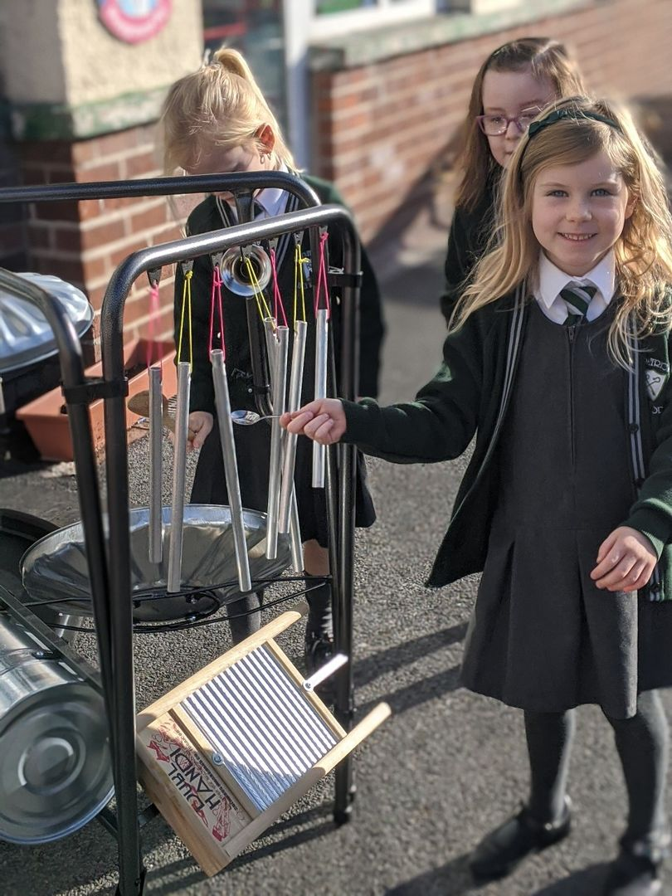
Activity-Based Learning & Structured Play
Learning through structured play and activities essential in Foundation Stage and Key Stage 1.
Literacy, Numeracy, World Around Us, STEM and ICT developed through ABL / PBL
Love of learning fostered
Children learn to take risks, to explore, to test and to collaborate
Primary 3 pupils may be given short focused lessons during ABL / PBL when needed
Opportunities for differentiation in all activities
Play activities include construction, writing, maths, small world, role-play, problem solving, creative tasks, sand and water activities, ICT and reading

Slide 5
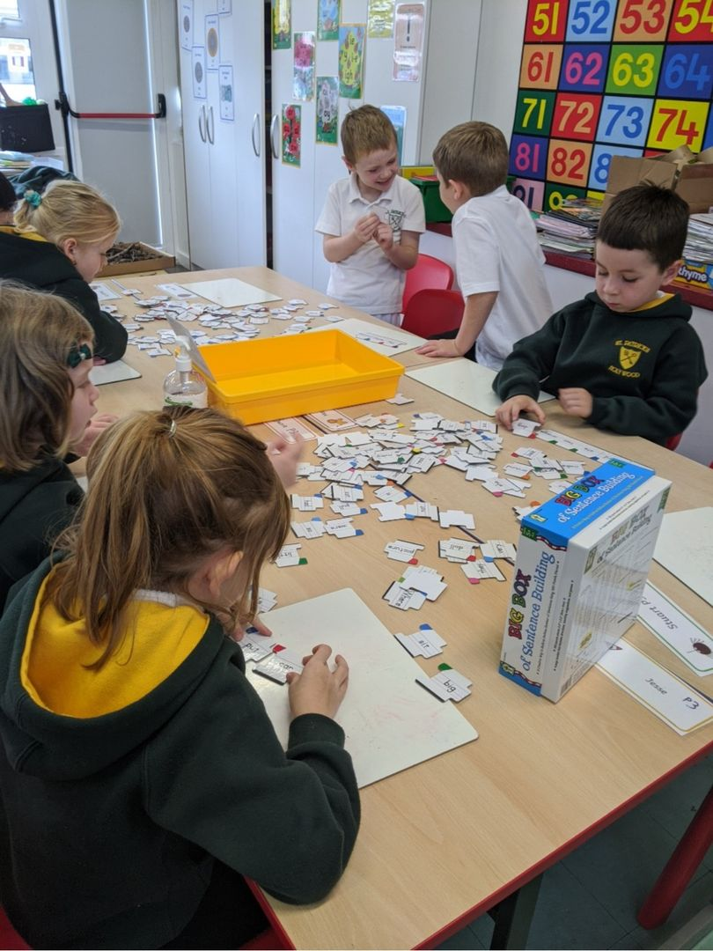
Literacy Curriculum
Taskboard teaching: 3 sessions per week
Writing teaching: 2 sessions per week
Learning objectives practices, consolidated and extended through ABL/PBL
Phonics approach to reading and spelling
Guided reading sessions daily
Writing types change with each half term and include:
Recount
Instructional
Report
Narrative
Persuasive

Slide 6
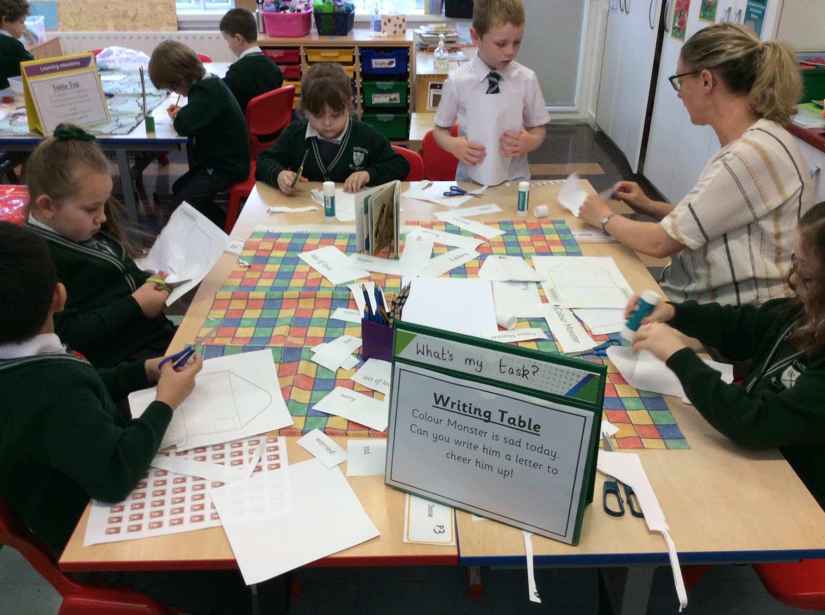
Literacy Curriculum - Writing
Modelled writing by an adult
Shared writing – children participate by contributing ideas and knowledge
Independent writing – use skills and knowledge
Need to experience many different types of writing – labels, lists, recipes, cards etc.
Handwriting developed through the Nelson Handwriting Scheme
Encourage correct pencil grip
Basic sentence structure, capital letters, full stops, question marks and exclamation marks

Slide 7
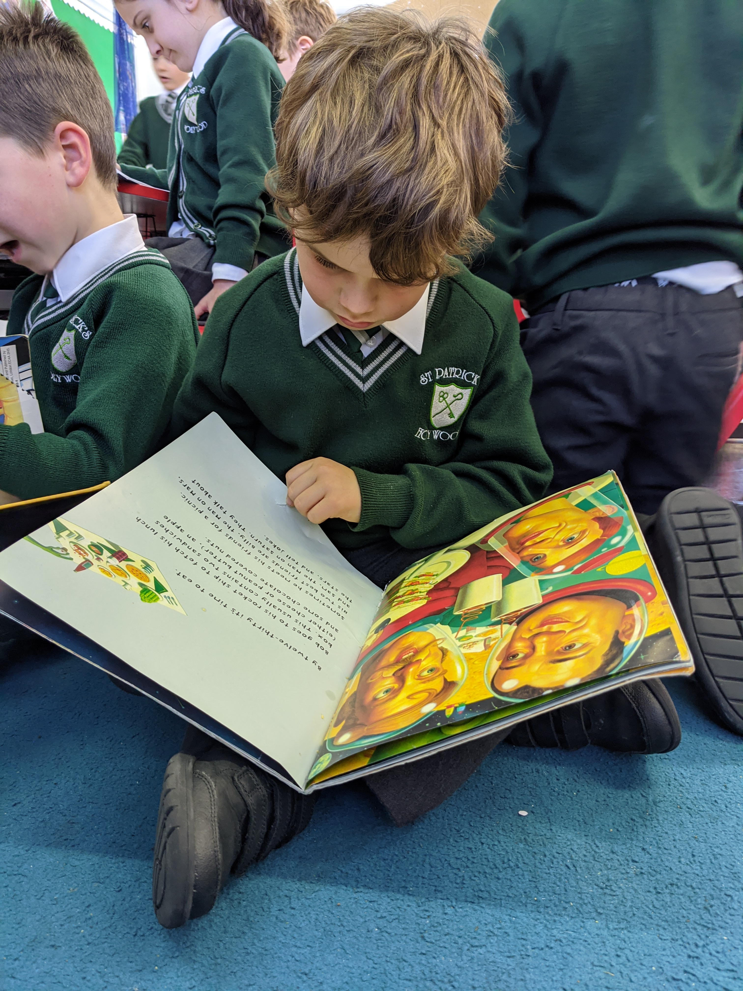
Literacy Curriculum - Reading
Modelled reading – adult demonstrates, talks out loud and strategies and reads with fluency and expression
Shared reading – teacher and children read a text together with a specific focus to develop confidence
Guided reading – talk, read and think their way through an unfamiliar text
Consolidate all previous learning and read at own pace through the book
Reading strategies are reinforced through guided sessions
Reading is reinforced ay home through the Bug Club reading scheme. Children are set books that can be read independently at home. They are set books working at the level below that which they are working on in school.

Slide 8
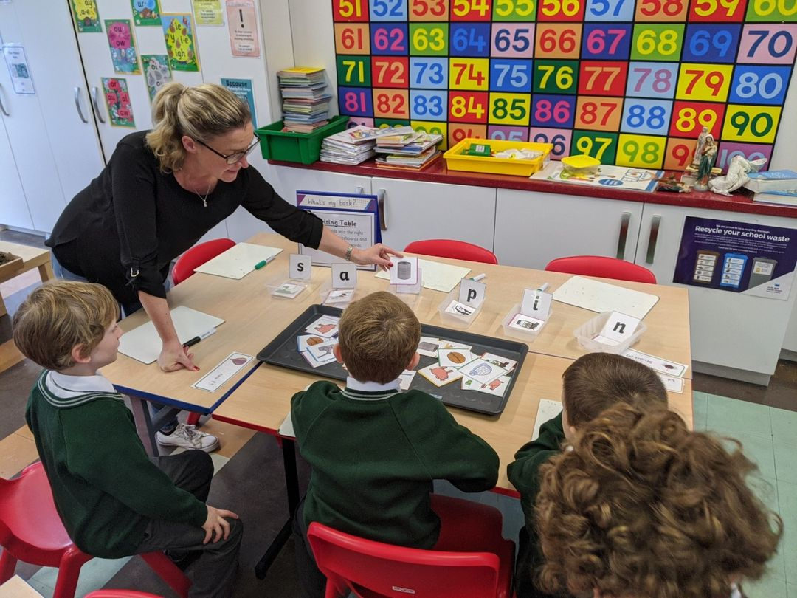
Literacy Curriculum - Phonics
Children will be taught to:
Remember sounds, rhymes and stories
Know words that rhyme
Identify words that begin/end with same /different sound
Identify words with the same/different middle vowel (difficult)
Identify different letter shapes
Complete 42 sounds – improve skills of segmenting (break up) and blending (make sounds into words)
10 minutes phonic blast everyday – constant practice develops skills and confidence
The beginning of this year has been spent revising sounds for P3 and introducing sounds and letters with P2 that we didn’t have the opportunity to cover in class last year.

Slide 9
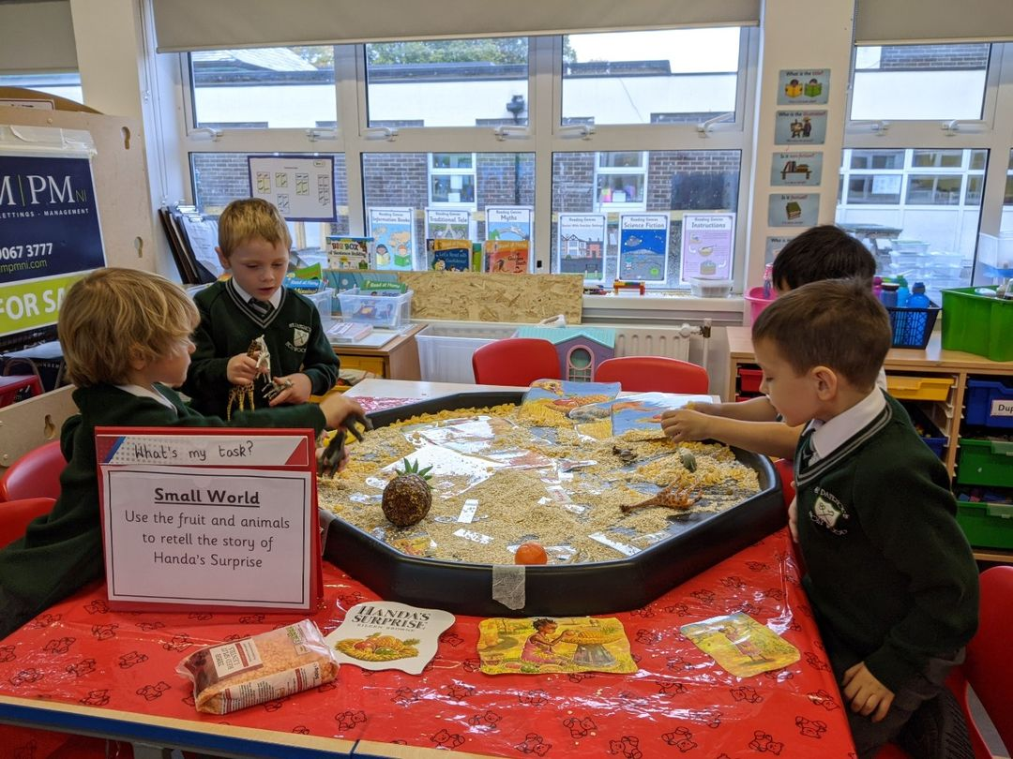
Literacy Curriculum – What you can do to help
Talking and Listening
Practise demonstrating listening skills with your child maintaining eye contact and getting them to focus their attention
Engage in discussions, conversations, retelling stories
Reading
Read (model) a variety of texts – fiction/non-fiction, poetry. Read instructions in cookbooks, labels on packs and signs, put subtitles on a movie!
Talk about books – predict story/content/endings
Visit the library
Make sure to read material assigned to your child on BugClub
Writing
Large arm movements – games, painting etc.
Fine motor skills- cutting, using dough, drawing etc.
Write for fun – highlight differences between letters, words and sentences – make cards, posters, books etc.
Phonics
Encourage your child to sound out words for you and name letters
Practice simple word building and blending
Use rhyming to help children spell
Practise spellings sent home each night

Slide 10
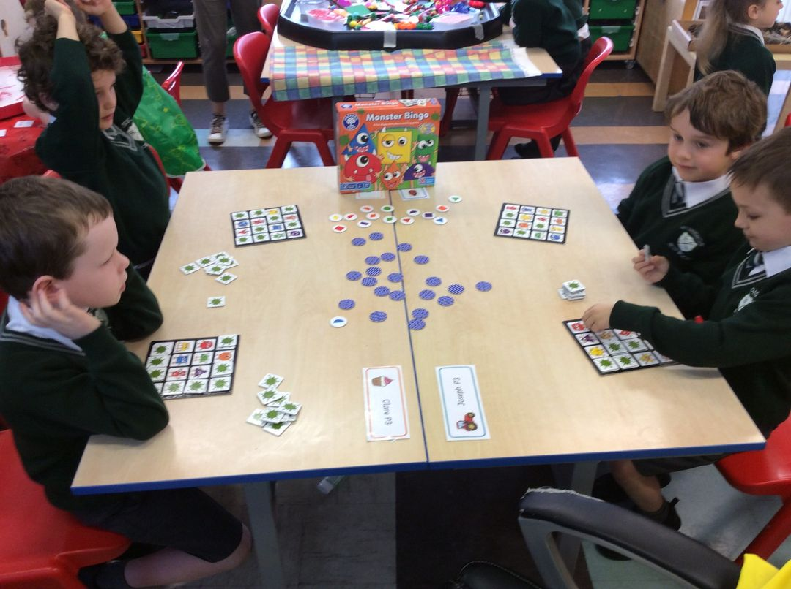
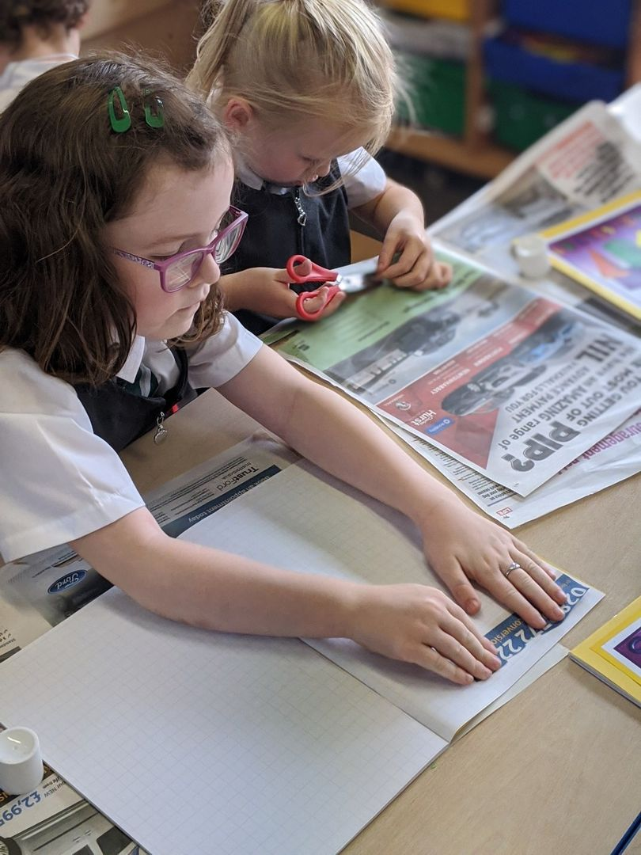
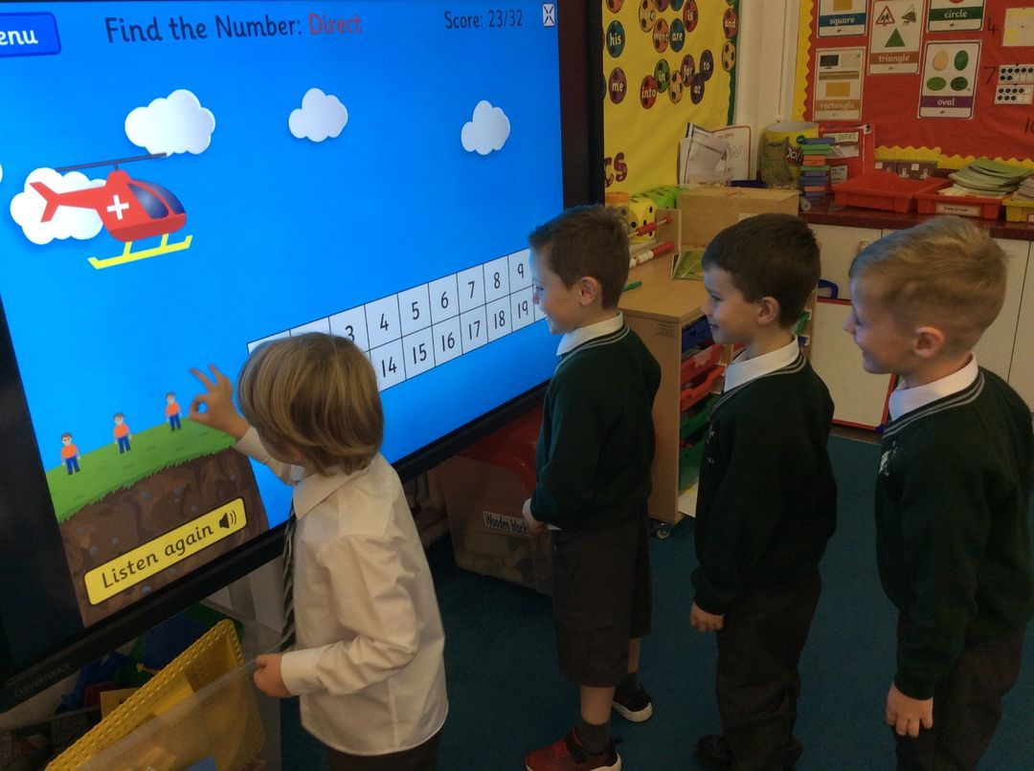
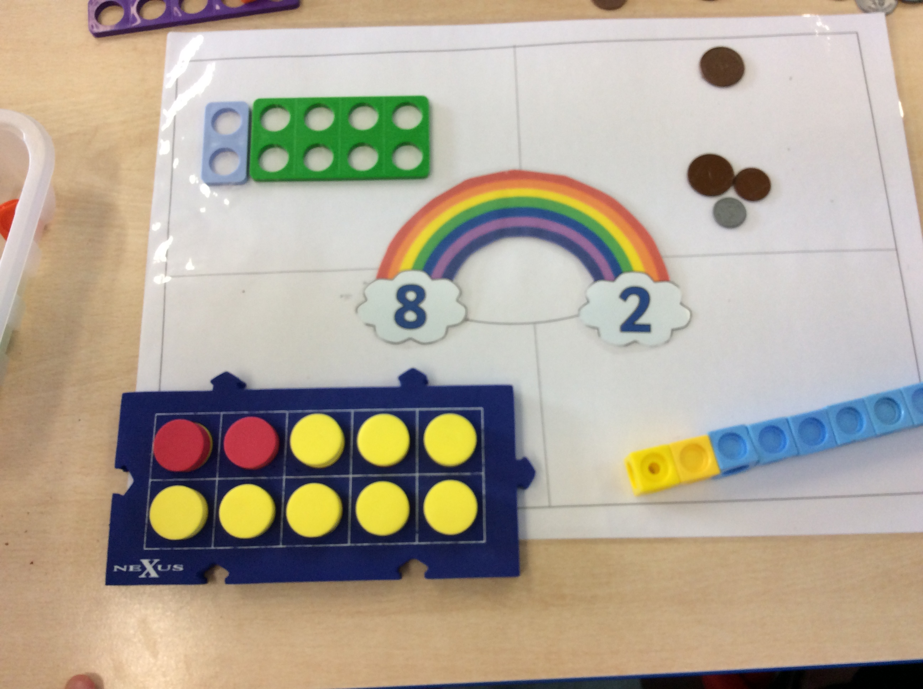
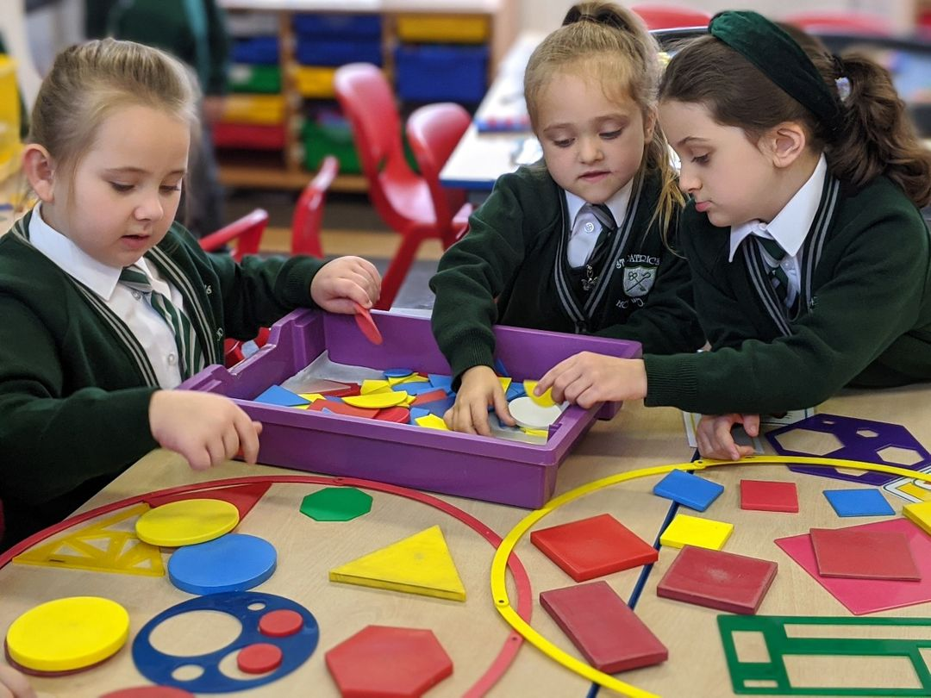
Numeracy and Mathematics Curriculum
Mental maths session daily
Focus on understanding number and mathematical processes
Mathematic skills practised, consolidated and extended through ABL / PBL
P2 focus on numbers within 20 but extending to within 30/50.
P3 focus on numbers within 30/50/100. Huge focus on calculation strategies and place value
Lessons take place to develop knowledge, skills and understanding of Problem solving, Shape, Space, Measures and Data Handling

Slide 11
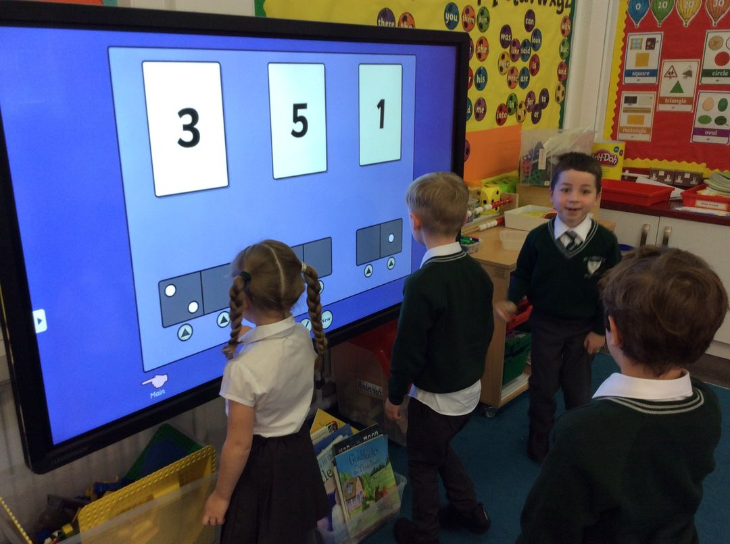
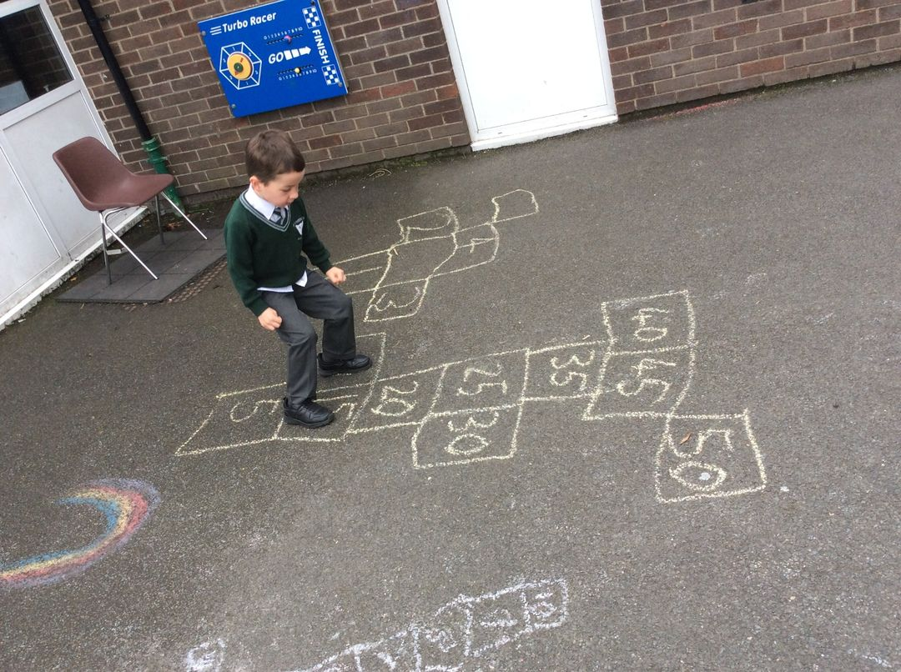
Numeracy Curriculum
Re-ordering
Counting on/ Counting back
Partitioning
The Seven Strategies for Mental Calculation
Rounding And Adjusting
Using Equivalence
Inverse Operations
Using Factors

Slide 12
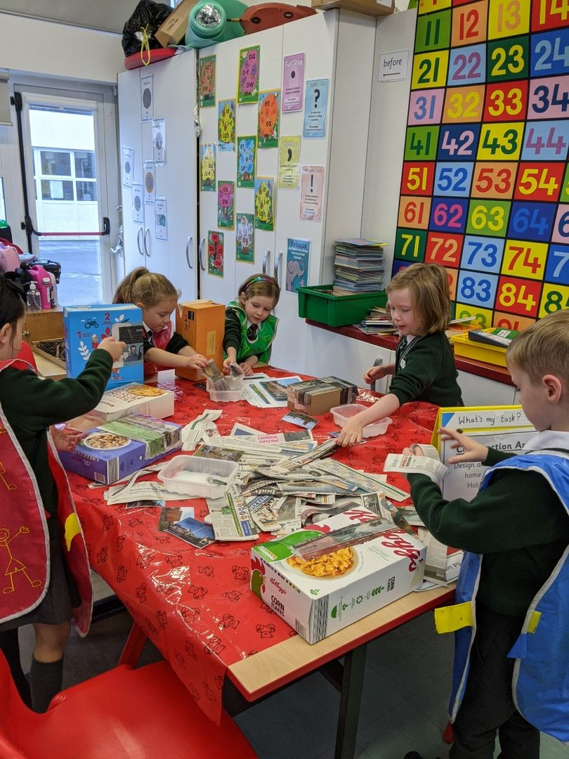
World Around Us
Increasing understanding & observational skills.
Developing skills of research
Developing thinking skills and personal capabilities
Range of topics covered: Celebrations, Superheores and Julia Donaldson
Children are actively engaged in a topic and will do research in class and at home
Topic work is reinforced through PBL activities and a series of planned Educational Visits

Slide 13
Homework
Homework given on Monday, to be returned by Friday
There will be a Book 1 and a Book 2, exchanged weekly to allow for marking, preparation and quarantining where appropriate
Children will be assigned one or two BugClub fun readers each week
Mental maths and spellings learning each week (P3 only initially, then P2 later in the year)
Children may receive activities to complete on the My Maths App
Purple Mash homework on occasion

Slide 14
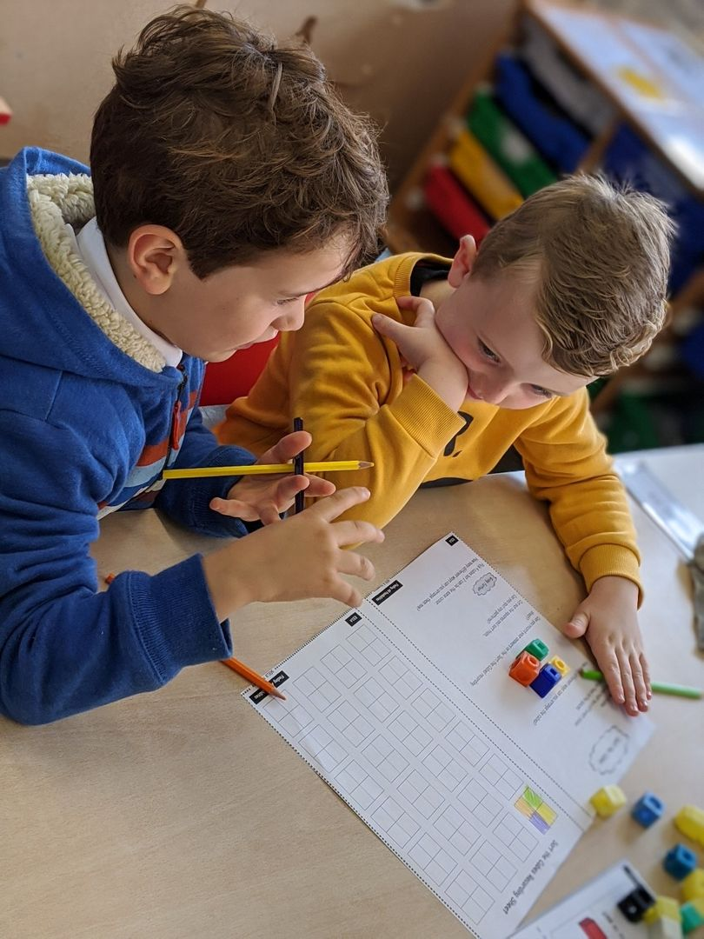
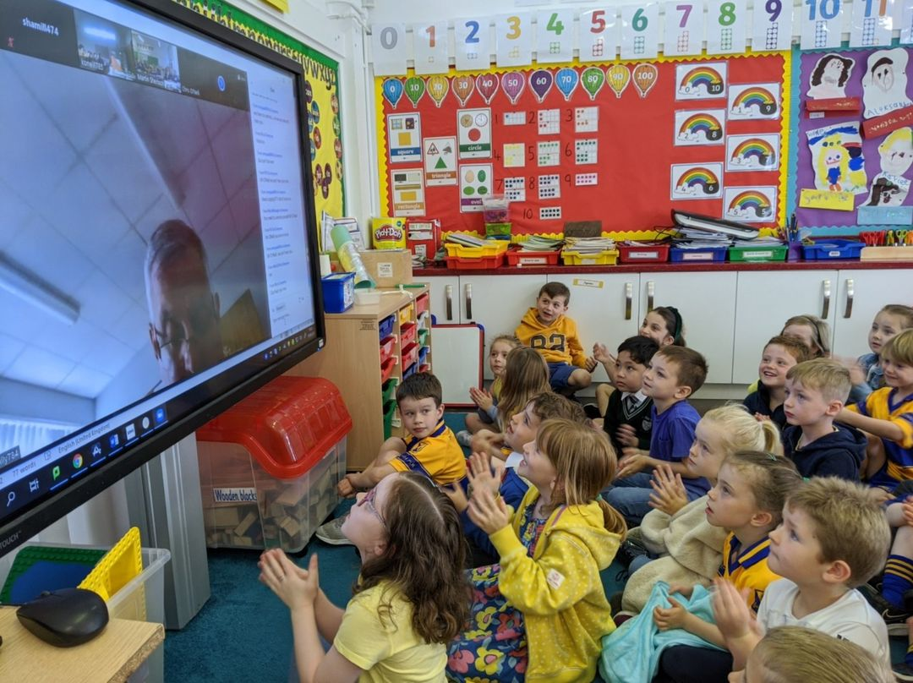
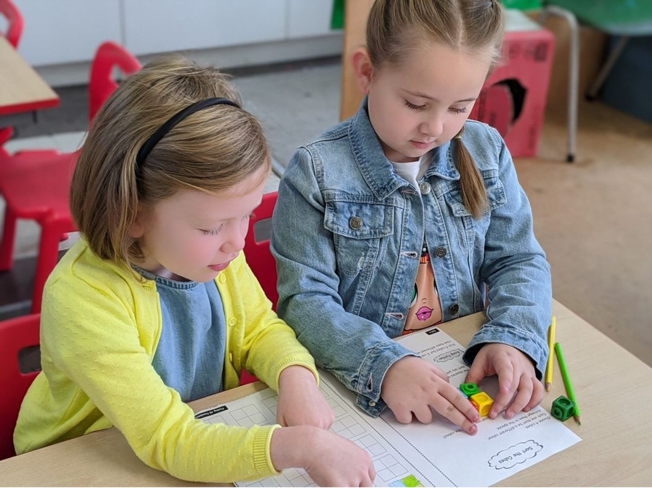
Other Areas
Behaviour:
High expectations for behaviour, particularly attention and listening
Punctuality important
Positive reinforcement strategies key
Traffic light system to manage inappropriate behaviour
Open dialogue between home and school essential
Special Needs:
IEPS – Used to create targets for progression (changes to come in this area)
Differentiated work used to ensure each child is challenged
Withdrawal support may be available depending on Covid 19 restrictions
Assessment:
Continuous assessment
Progress in Maths / Progress in English administered for P3s at the end of the year

Slide 15
Thank You

